Slide 1
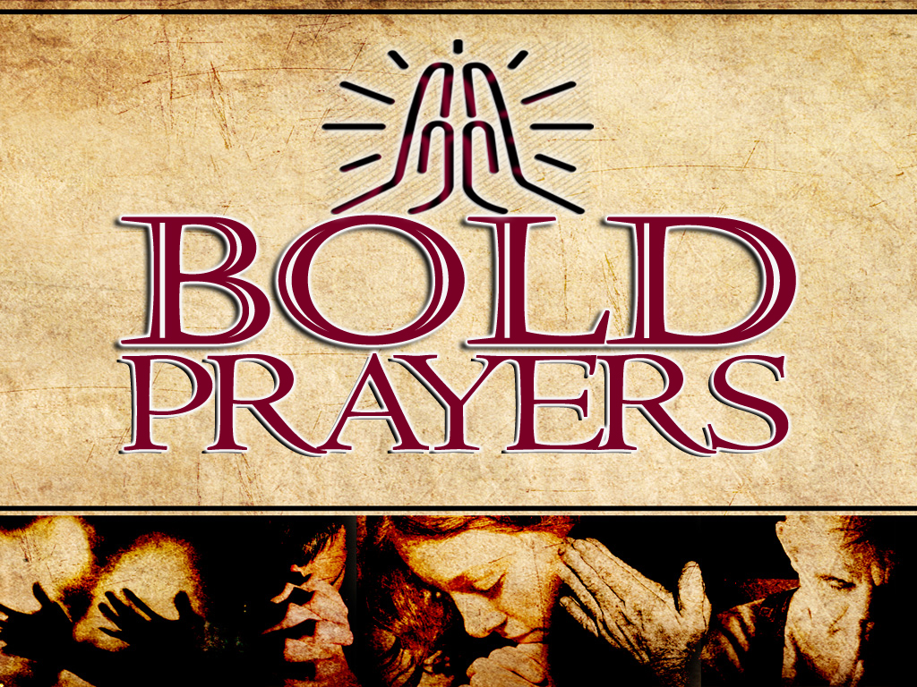

Slide 2
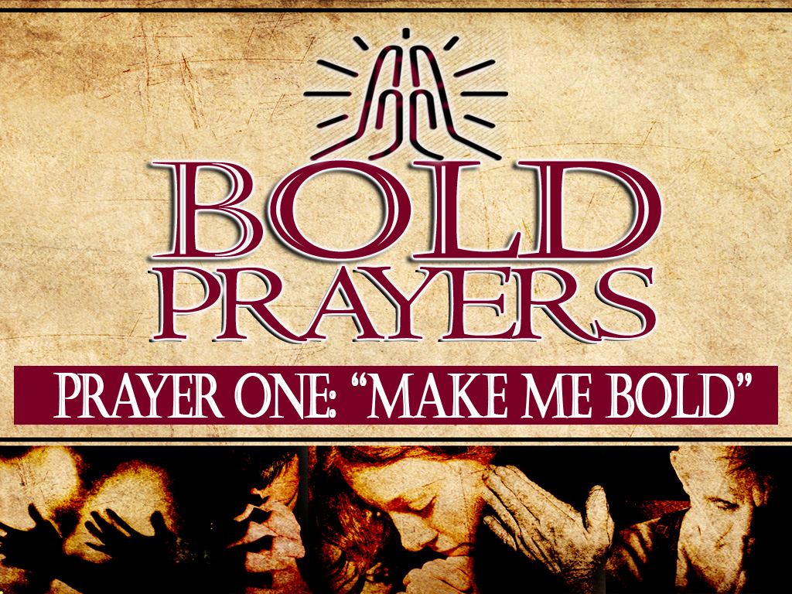

Slide 3
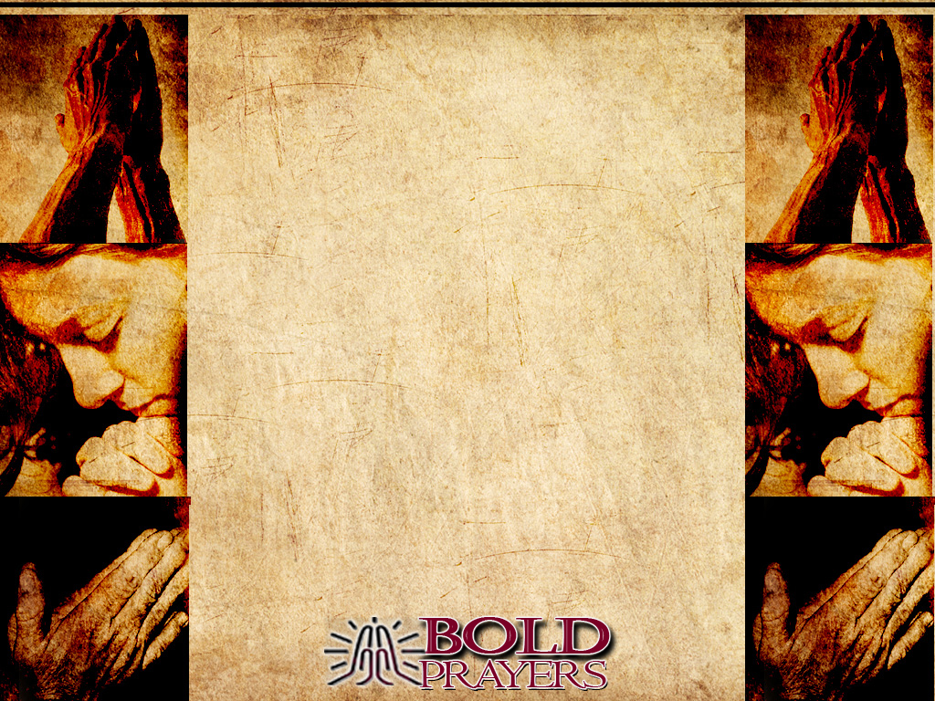
Acts 3:1-10

Slide 4
ACTS 4:10
Let me clearly state to all of you and to all the people of Israel that he was healed by the powerful name of Jesus Christ the Nazarene, the man you crucified but whom God raised from the dead.

Slide 5
ACTS 4:13
The members of the council were amazed when they saw the boldness of Peter and John, for they could see that they were ordinary men with no special training in the Scriptures.

Slide 6
“...amazed because they were ordinary men”
Greek for Ordinary:
IDIOTES

Slide 7
ACTS 4:29
And now, Oh Lord, hear their threats, and give us, your servants, great boldness in preaching your word.

Slide 8

Acts 4:29-31
And now, Oh Lord, hear their threats, and give us, your servants, great boldness in preaching your word.

Slide 9
Acts 4:29-31
30 Stretch out your hand with healing power; may miraculous signs and wonders be done through the name of your holy servant Jesus.”

Slide 10
Acts 4:29-31
31 After this prayer, the meeting place shook, and they were all filled with the Holy Spirit. Then they preached the word of God with boldness.

Slide 11
Acts 5:18-20
They arrested the apostles and put them in the public jail. ¹⁹ But an angel of the Lord came at night, opened the gates of the jail, and brought them out. Then he told them, ²⁰ “Go to the Temple and give the people this message of life!”

Slide 12

1. Spiritual Boldness almost always triggers spiritual opposition.
• Acts 5:18

Slide 13
2. Spiritual Boldness often releases God’s Miracles.
• Acts 5:19

Slide 14
3. Spiritual Boldness always requires Faith.
• Acts 5:20-21

